Slide 1
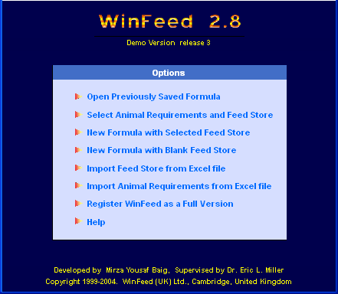
Aplikasi Win Feed dalam FORMULASI RANSUM
MK. Teknik Formulasi Ransum dan SIP
Department of Nutrition and Feed Technology
Faculty of Animal Science – Bogor Agricultural University
Website: http://intp.ipb.ac.id

Slide 2
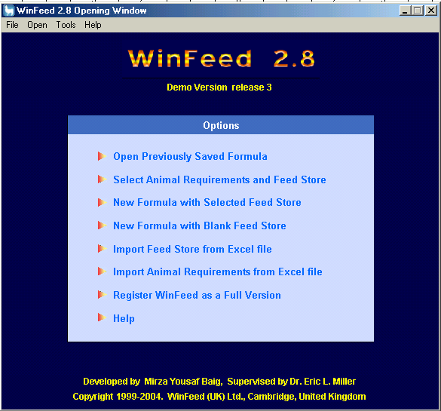
Program Win Feed
Dikembangkan Laboratory of Nutrition, University of Cambridge, UK
Program ini sederhana dapat dipergunakan untuk menyusun ransum ruminansia atau non ruminansia

Slide 3
Program Win Feed
Winfeed merupakan program formulasi ransum yang sederhana dan beroerientasi pada pemecahan masalah berdasarkan prinsif LP. Sebagian besar menu menggambarkan fungsinya sendiri. Bagi yang sudah familiar dengan MS Windows dan terminologi dasar dari ilmu nutrisi ternak dapat mempelajari program ini dalam beberapa menit.
WinFeed membuat formula ransum dengan harga termurah untuk ternak ruminansia dan non ruminansia melalui 2 metode :
Linear Feed Formulation
Stochastic Feed Formulation

Slide 4
Prinsip Linear Program
Minimisasi c₁x₁ + c₂x₂ + c₃x₃ + ... + c_{j}x_{j}
Kendala
a₁₁x₁ + a₂₁x₂ + a₃₁x₃ + ... + a_{ij}x_{j} > b₁
a₁₂x₁ + a₂₂x₂ + a₃₂x₃ + ... + a_{ij}x_{j} > b₂
......
a_{i2}x₁ + a_{i2}x₂ + a_{i2}x₃ + ... + a_{ij}x_{j} > b_{i}
Asumsi
x₁ + x₂ + x₃ + ... + x_{j} = 1
x₁, x₂, x₃, ... , x_{j} > 1
c_{j} = harga bahan pakan
x_{j} = jumlah penggunaan
bahan pakan
a_{ij} = kandungan nutrien
dalam bahan pakan
b_{i} = kebutuhan nutrien

Slide 5
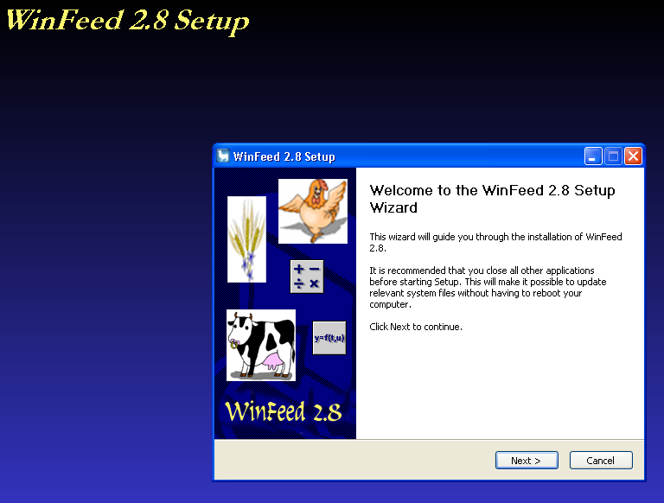
Cara Install WinFeed (1)
Click WINFEED283.EXE
Click NEXT >

Slide 6
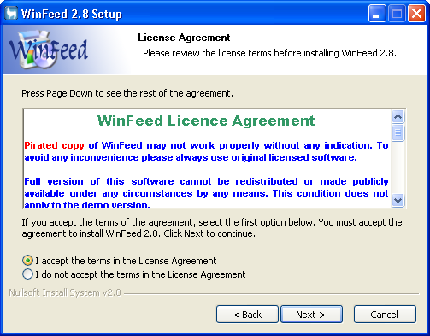
Cara Install WinFeed (2)
Click I accept in the terms in license agreement
Click NEXT >

Slide 7
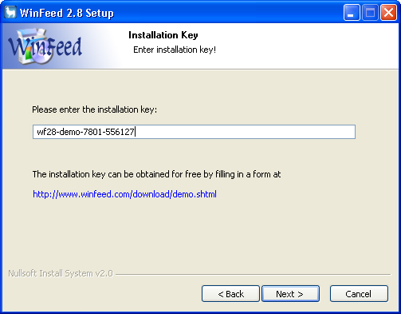
Cara Install WinFeed (3)
Tuliskan license key
Click NEXT >

Slide 8
Tahapan dalam Formulasi
Membuat Database Pakan
Pilih Bahan Pakan yang akan digunakan
Check list nama bahan pakan
Periksa harga pakan
Kembali (Go Back )
Masukan Kebutuhan Nutrien (Nutrient Requirement)
Hitung (Formulate)

Slide 9
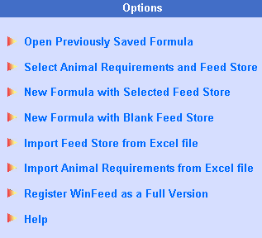
Menu Utama (Options)
Buka formula sebelumnya
Pilih kebutuhan nutrien dan bahan baku
Formula baru dari bahan baku terpilih
Formula baru dari database baru
Import bahan baku dari file Excel
Import kebutuhan ternak dari file Excel
Register
Help

Slide 10
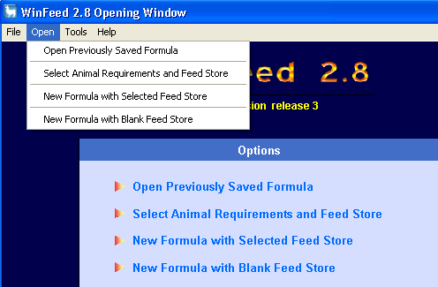
Menu Utama (Pop Up Menu)

Slide 11
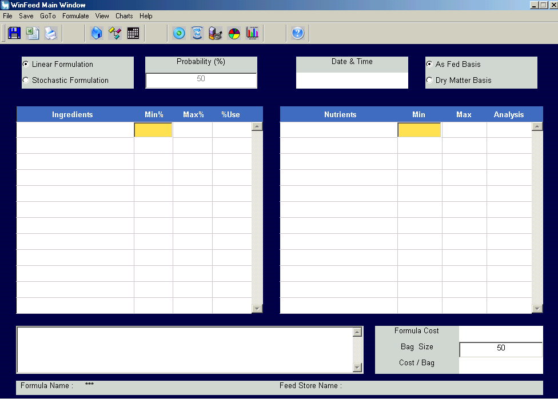
Menyusun ransum baru dengan data bahan pakan baru (New formula with blank feed store)
Nutrient Requirement
Ingredient List

Slide 12
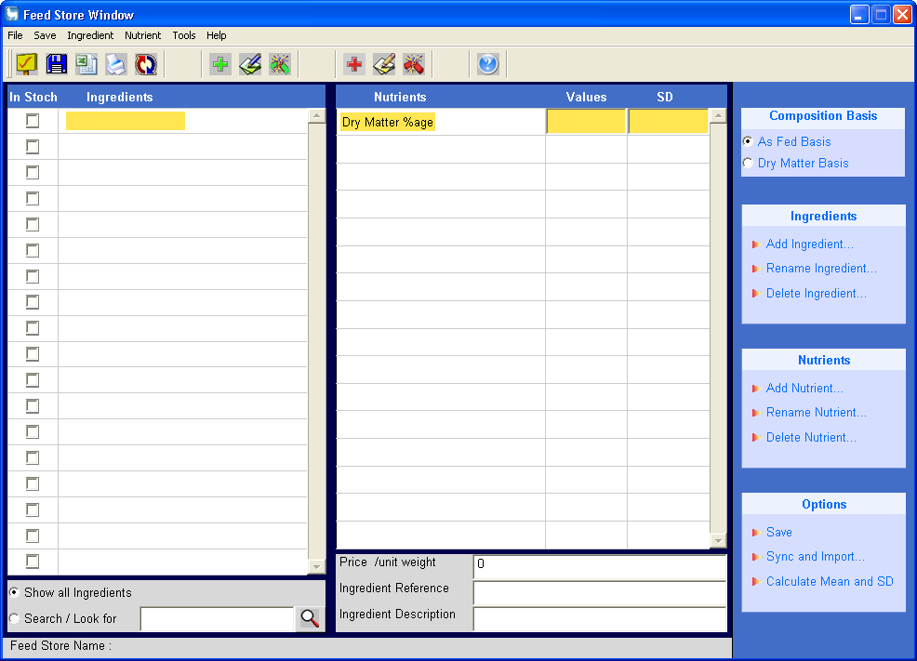
Membuat database bahan pakan (New formula with blank feed store)
Tuliskan nama bahan pakan
Tuliskan nama nutrien
Pastikan komposisi nutrien dalam dry matter basis atau as feed basis
Masukan kandungan nutrien dan harga dari setiap bahan pakan

Slide 13
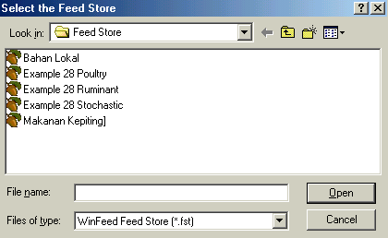
Membuat ransum baru (New Formula with Selected Feed Store)
Pilih data base bahan pakan (Select the feed Store)

Slide 14
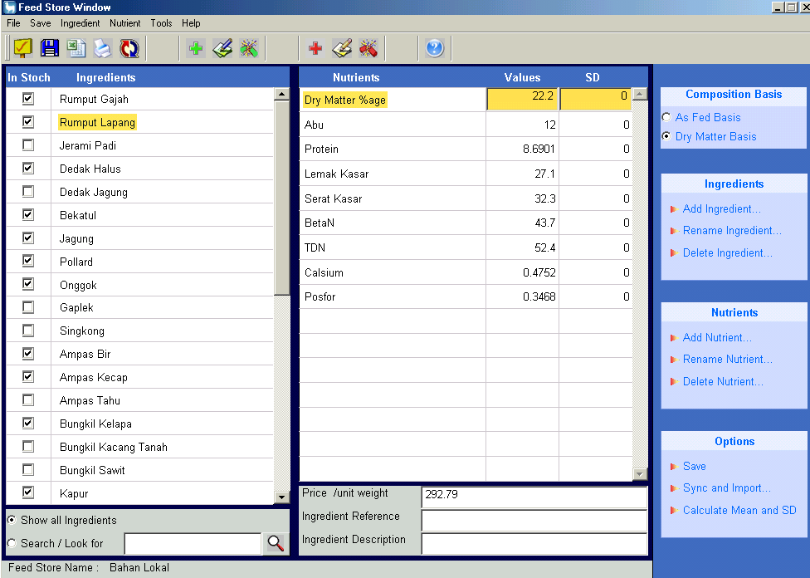
Data base bahan pakan (Feed Store)
Contreng bahan pakan yang dipilih
Click Go Back

Slide 15
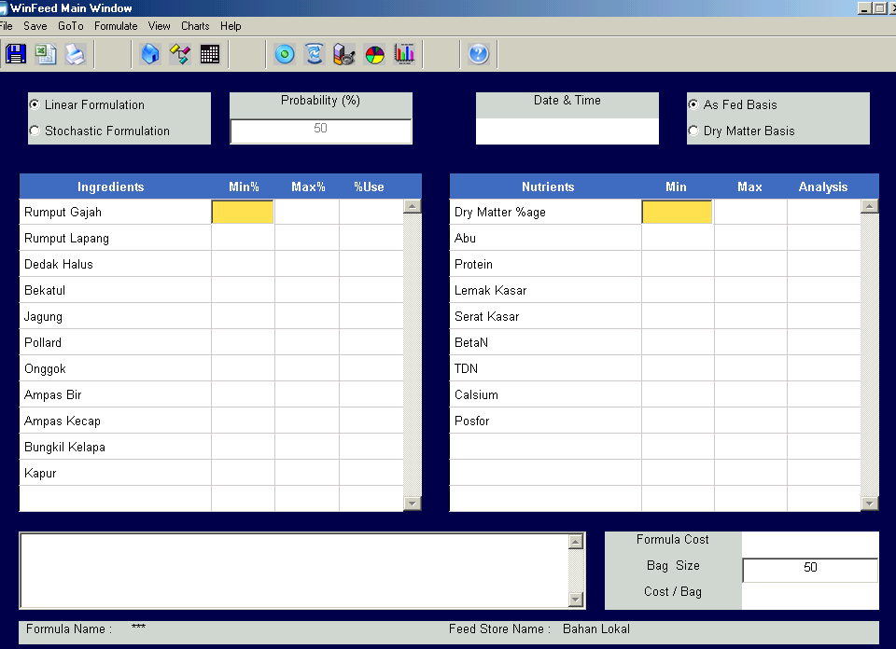
Pilih bahan pakan yang digunakan (Selected Ingredients)

Slide 16
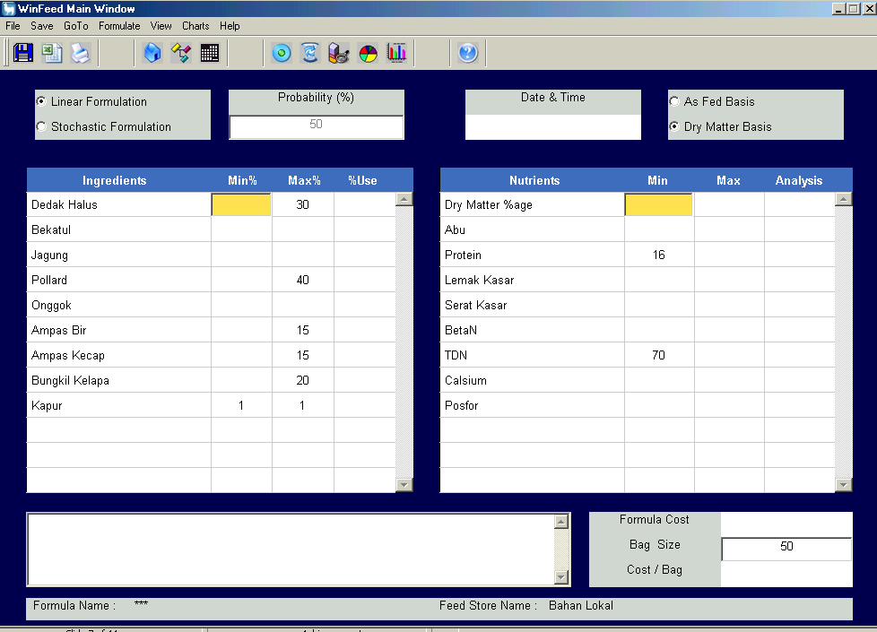
Pembatasan bahan pakan dan nutrien (Ingredient & Nutrient Constraints)
Tuliskan batas penggunaan MIN dan MAX bahan pakan
Tuliskan batas MIN dan MAX kebutuhan nutrien
Click FORMULATE

Slide 17
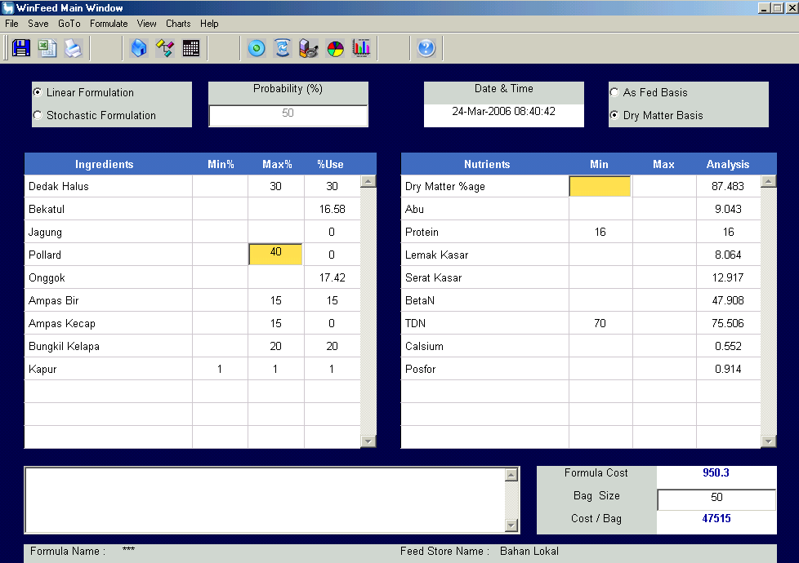
Ransum hasil formulasi

Slide 18
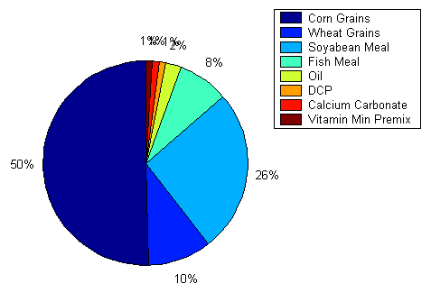
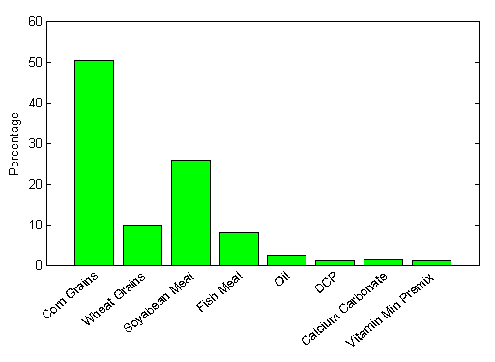
Komposisi ransum dalam grafik

Slide 19
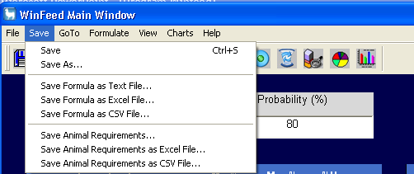
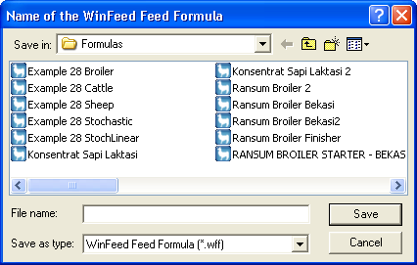
Simpan file (Save, Save As)
Save (nama file)

Slide 20
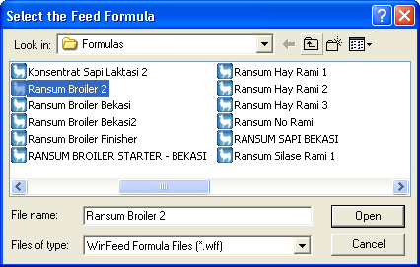
Buka file ransum sebelumnya (Open previously saved formula)

Slide 21
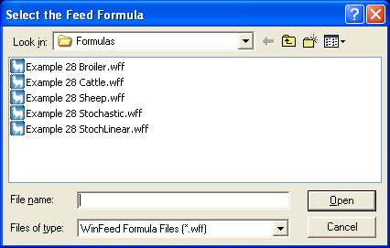
1. Open an already saved formula
Menu ini menyediakan fasilitas untuk melihat hasil formulasi yang sudah disimpan. Beberapa contoh formula disediakan oleh WinFeed yang langsung bisa dibuka dari menu ini.

Slide 22
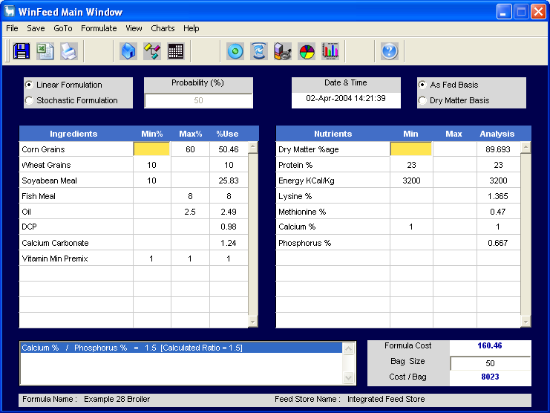

Slide 23
Quis menjelang siang
Apa persamaan dan perbedaan metode Linier dan Stochcatic pada Win Feed ?
Untuk memudahkan pengelolaan database pakan ruminan dan monogastrik sebaiknya disatukan. Benar atau Tidak ?
Apa yang dimaksud dengan Swing dalam formulasi pakan?
Bagaimana cara membuat agar bahan pakan dalam ransum seimbang?

Slide 24
2. Select Animal Requirement Set and an appropriate Feed Store
Menu ini merupakan menu utama dari WinFeed. WinFeed menyediakan fasilitas untuk menyimpan kebutuhan nutrisi ternak (animal’s nutrient requirement) dalam satu file dan “Feed Store” (database komposisi bahan pakan) di file lain.
Contoh, kita dapat mempuanyai berbagai jenis kebutuhan nutrien :
Nutrient Requirements for Broiler",
"Nutrient Requirements for Layer Finisher",
Nutrient Requirements for Lamb",
Nutrient Requirements for Dairy Cow" etc. dalam file terpisah.

Slide 25
Hal yang sama, kita dapat menyimpan berbagai jenis “Feed Stores” seperti :
"Feed Store for Summer Season",
"Feed Store for Poultry",
"Feed Store for Region 1", "Feed Store for Cattle Region 2", etc.
Sekali kita mempunyai file-file yang sudah siap, kita dapat menggunakan opsi ini untuk memilih satu set kebutuhan seperti : "Nutrient Requirements for Broiler" dengan Feed Store seperti "Feed Store for Summer Season", dan kemudian memulai formulasi. Beberapa contoh set kebutuhan dan feed store sudah disediakan oleh winFeed.

Slide 26
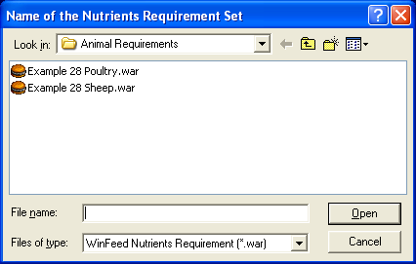
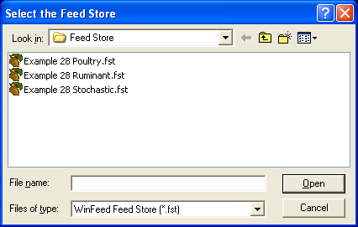

Slide 27
Start a new formula using an existing Feed Store
Dengan memilih opsi ini, kita dapat memulai membuat formula baru dengan “selected Feed Store”. Ketika kita “Click” opsi ini, kita akan diminta memilih file “Feed Store”
Setelah memilih Feed store, akan dibuka “Main Window” dimana kita dapat memilih bahan pakan yang akan digunakan dalam formulasi. Kita juga perlu memasukkan kebutuhan nutrien secara manual dalam ”Main Window”.

Slide 28
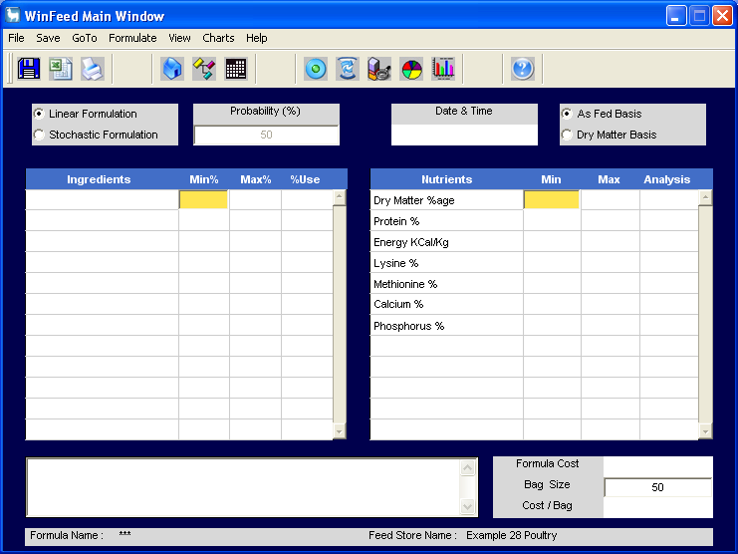

Slide 29
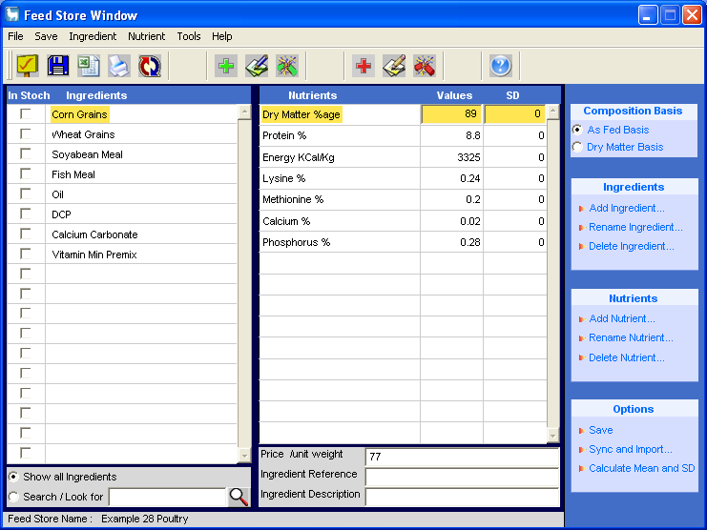

Slide 30
Start a brand new formula with a new Feed Store
Kemungkinan opsi ini akan kita gunakan pada saat pertama. Ketika kita memilih opsi ini, maka ”blank Feed Store” dan “blank formula” akan terbuka. Kita harus meng-entry bahan pakan, harga dan komposisi nutriennya dalam Feed Store Window. Feed Store Window dapat diakses dari Main Window. Kit ajuga perlu meng-entry nilai kebutuhan nutrien dalam Main Window.

Slide 31
Import Animal Nutrient Requirements from MS Excel file
This function lets you import Animal Requirements from an Excel file into WinFeed.
Many organisations publish Feeding Standards in MS Excel format.
After changing data order in these files according to WinFeed required pattern, these files can be directly import into WinFeed.
Thus this function not only saves your time but also prevents data entry type errors.

Slide 32
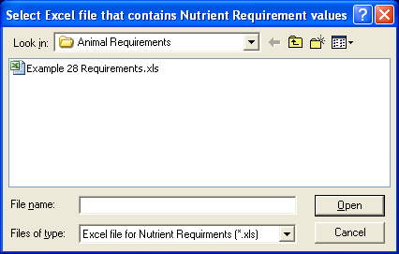

Slide 33
Import Feed Store from MS Excel file
This function lets you convert data from an Excel file into WinFeed Feed Store. This function is very sensitive and it will not work if any of the instructions given below is not followed.
If you are importing data for Stochastic Formulation then two Excel files are required to perform this task. If you are importing data for Linear Formulation then only one file containing Mean values is required.
These Excel files must be is a specific format. Two example Excel files are provided with WinFeed. These files should be examined thoroughly to understand the required format.

Slide 34
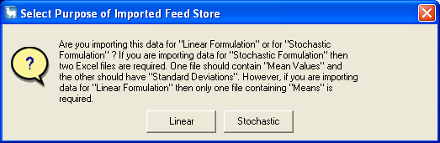
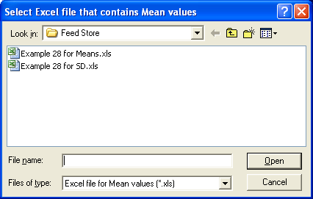

Slide 35
Main Window
This is the main window which contains all the controls for feed formulation. All selected ingredients, their minimum and maximum limits and calculated formula appear on left side. All nutrients, their minimum and maximum limits and nutrient analysis of the calculated formula appear on the right side.
Formulation Method
The formulation method can be selected as "Linear" or "Stochastic". The probability box will be automatically enabled if formulation method is selected as "Stochastic". The valid value of probability of success ranges from 50 to 99.99 %. Do not put "%" with the value. 80% will be written as 80. Please note that Stochastic Formulation at 50% probability of success is exactly same as Linear Formulation. It is because the standard normal deviate of 0.5 is zero.

Slide 36
Formulation Basis
The formulation Basis radio buttons provide options for "As-Fed Basis" or "Dry Matter Basis".
These options indicate basis for nutrient requirements. When entering nutrient requirements, you must tell WinFeed the basis for these requirements. This is a very critical point. An improper selection of basis will result in an incorrect formula.
In monogastric animals, e.g. poultry, usually nutrient requirements are reported on "As-Fed Basis". However, in ruminants requirements are expressed on "Dry Matter Basis". But this is not always the case. You must always look for basis when collecting nutrient requirement from any source.
The resultant formula will be on same basis as that of nutrient requirements.

Slide 37
Formula Price
The price per unit of the calculated formula appears under the Formula Price box. No units for weight or currency are mentioned here. The weight and currency units are same which are used in Feed Store database.
For example if ingredient price in the Feed Store is entered in £ /kg, the price of the formula will also be in £ /kg. If ingredient price in the Feed Store is entered in $ /ton, the price of the formula will also be in $ /ton. Because WinFeed does not take currency units in consideration while making formula, it is important that all price values should be entered in the same units throughout the programme

Slide 38
Ingredients' Min Max Limits
Feed formulation is done on percentage bases. Therefore, ingredients' minimum and maximum limits should be in percentage but without mentioning any symbol or unit. For example "5.8%" should be entered as "5.8".
If an ingredient has to be set at a fixed level then both minimum and maximum values should be entered as same. For example if you want to keep Mineral Mixture fixed at "1%" then its both min and max values should be "1".
Nutrients' Min Max Limits
Nutrient limits are not in any specific units. Any units could used to describe nutrient levels. However, these units should remain same through out the programme. To fix nutrient at a specific level use same values for minimum and maximum limits.

Slide 39
Bag Size and Cost per Bag
These fields show feed bag size and the price of one bag. These values are useful for commercial feed millers. They can have a quick look that if current formula is used, what will be the cost of a bag. Usually feed bags are of 50 Kg, therefore default bag size is 50. If you are using a different size bag or you want to see the price of whole batch, this default value can be changed according to the requirement.

Slide 40
Save Animal's Nutrient Requirements
This function lets you save Animal's Nutrient Requirement Set in a separate file. These files can be used in future for formulation. To find out how to use them please see help section of Opening Window.
Save Formula as a Text File
By selecting this command under File menu you can save a formula and its nutrient analysis in a text file. This text file can be opened in Microsoft Word or Microsoft Excel for further processing.
Save Formula as CSV file
A CSV file is a "Comma Separated Values" text file. This is a common format to exchange data between different worksheet and database applications. If you intend to transfer your final formula into MS Excel or any other database, you can save your formula as CSV file. In these files each value is separated by a comma. MS Excel puts every value separated by a comma into a separate cell. Once you have opened a CSV file in MS Excel, save it as Excel file (.xls) for further use.

Slide 41
Feed Store Window
This window manages a database of all available ingredients and their nutrient composition. Ingredient names are listed on the left side and nutrient details appear on the right side. There is no limit for maximum number of ingredients or nutrients in the database.
Ingredient List
A list of all ingredient in the Feed Store database is displayed on left side of the Feed Store window.

Slide 42
In Stock
WinFeed does not use any ingredient unless it is available or declared as In Stock. Left to Ingredient list in the Feed Store is a series of check boxes. If a box is checked, it shows that ingredient is available and could be used for formulation. If an ingredient is not available or you do not want to include that ingredient in formulation, just un-check its corresponding box by clicking on it. Once the check box is clear, that ingredient will not be used in formulation.
Whenever a new ingredient is added, it corresponding check box will be clear and that ingredient will not be used in formulation until it corresponding check box is crossed by clicking on it.

Slide 43
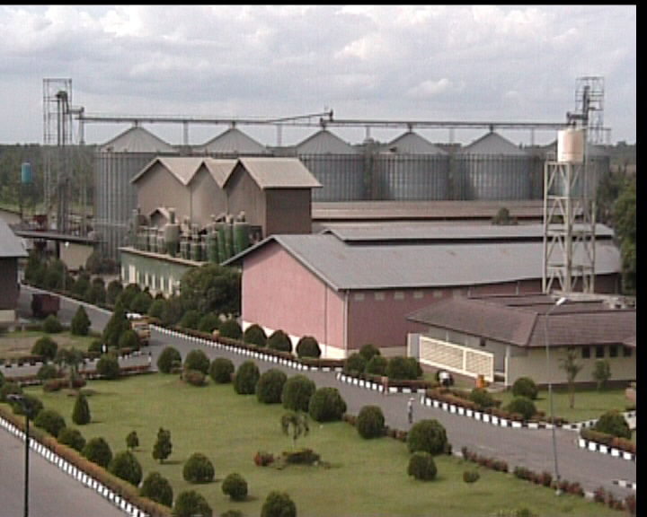
Thank You

